Slide 1

Convolutional Neural Networks
Computer vision
deeplearning.ai

Slide 2
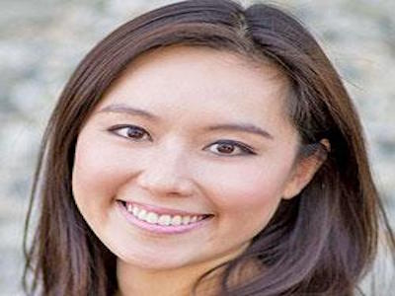
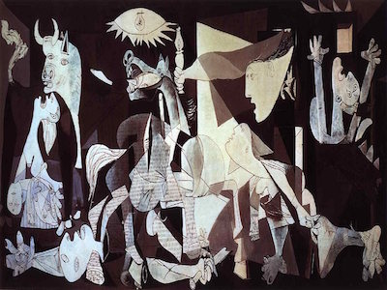
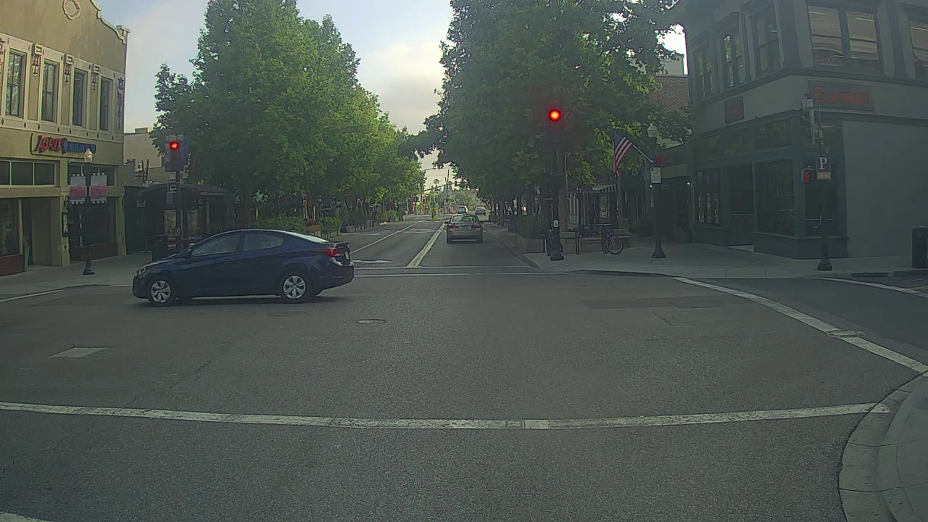
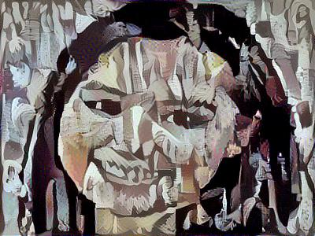
Computer Vision Problems
Image Classification
Neural Style Transfer
Cat? (0/1)
64x64
Object detection

Slide 3
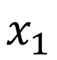
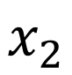
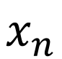
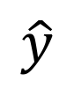
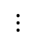
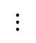
Deep Learning on large images
Cat? (0/1)
64x64
$$x_{1}$$
$$x_{2}$$
$$⋮$$
$$⋮$$
$$⋮$$
$$\hat{y}$$
$$x_{n}$$
Notes:
图片很大
weight的dim很大很大
Causing：
And with that many parameters,
it's difficult to get enough data to prevent a neural network from overfitting.
And also, the computational requirements and the memory requirements to train
a neural network with three billion parameters is just a bit infeasible.

